Slide 1
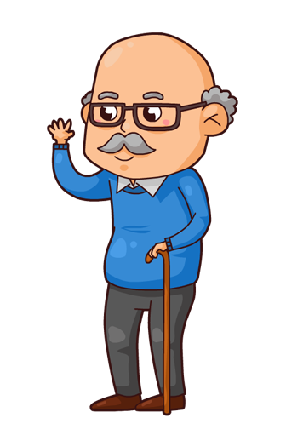
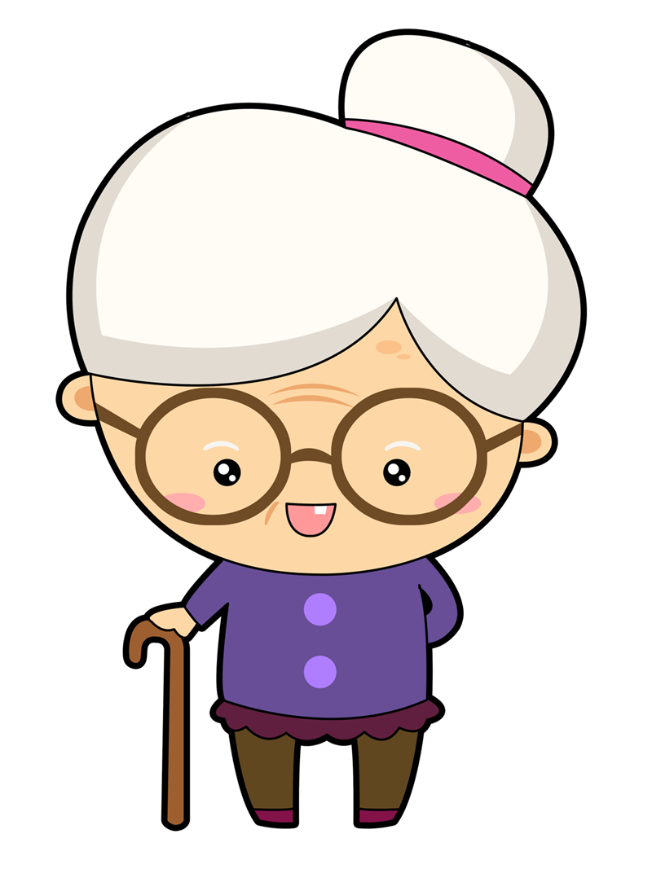
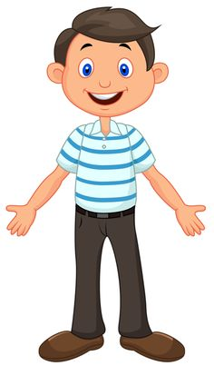
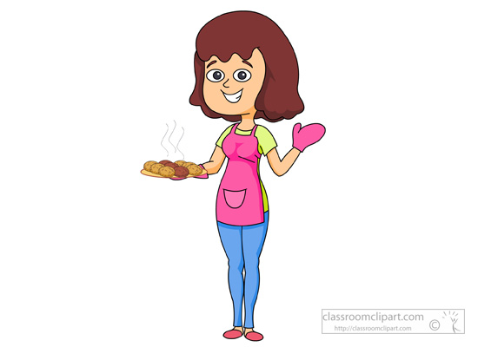
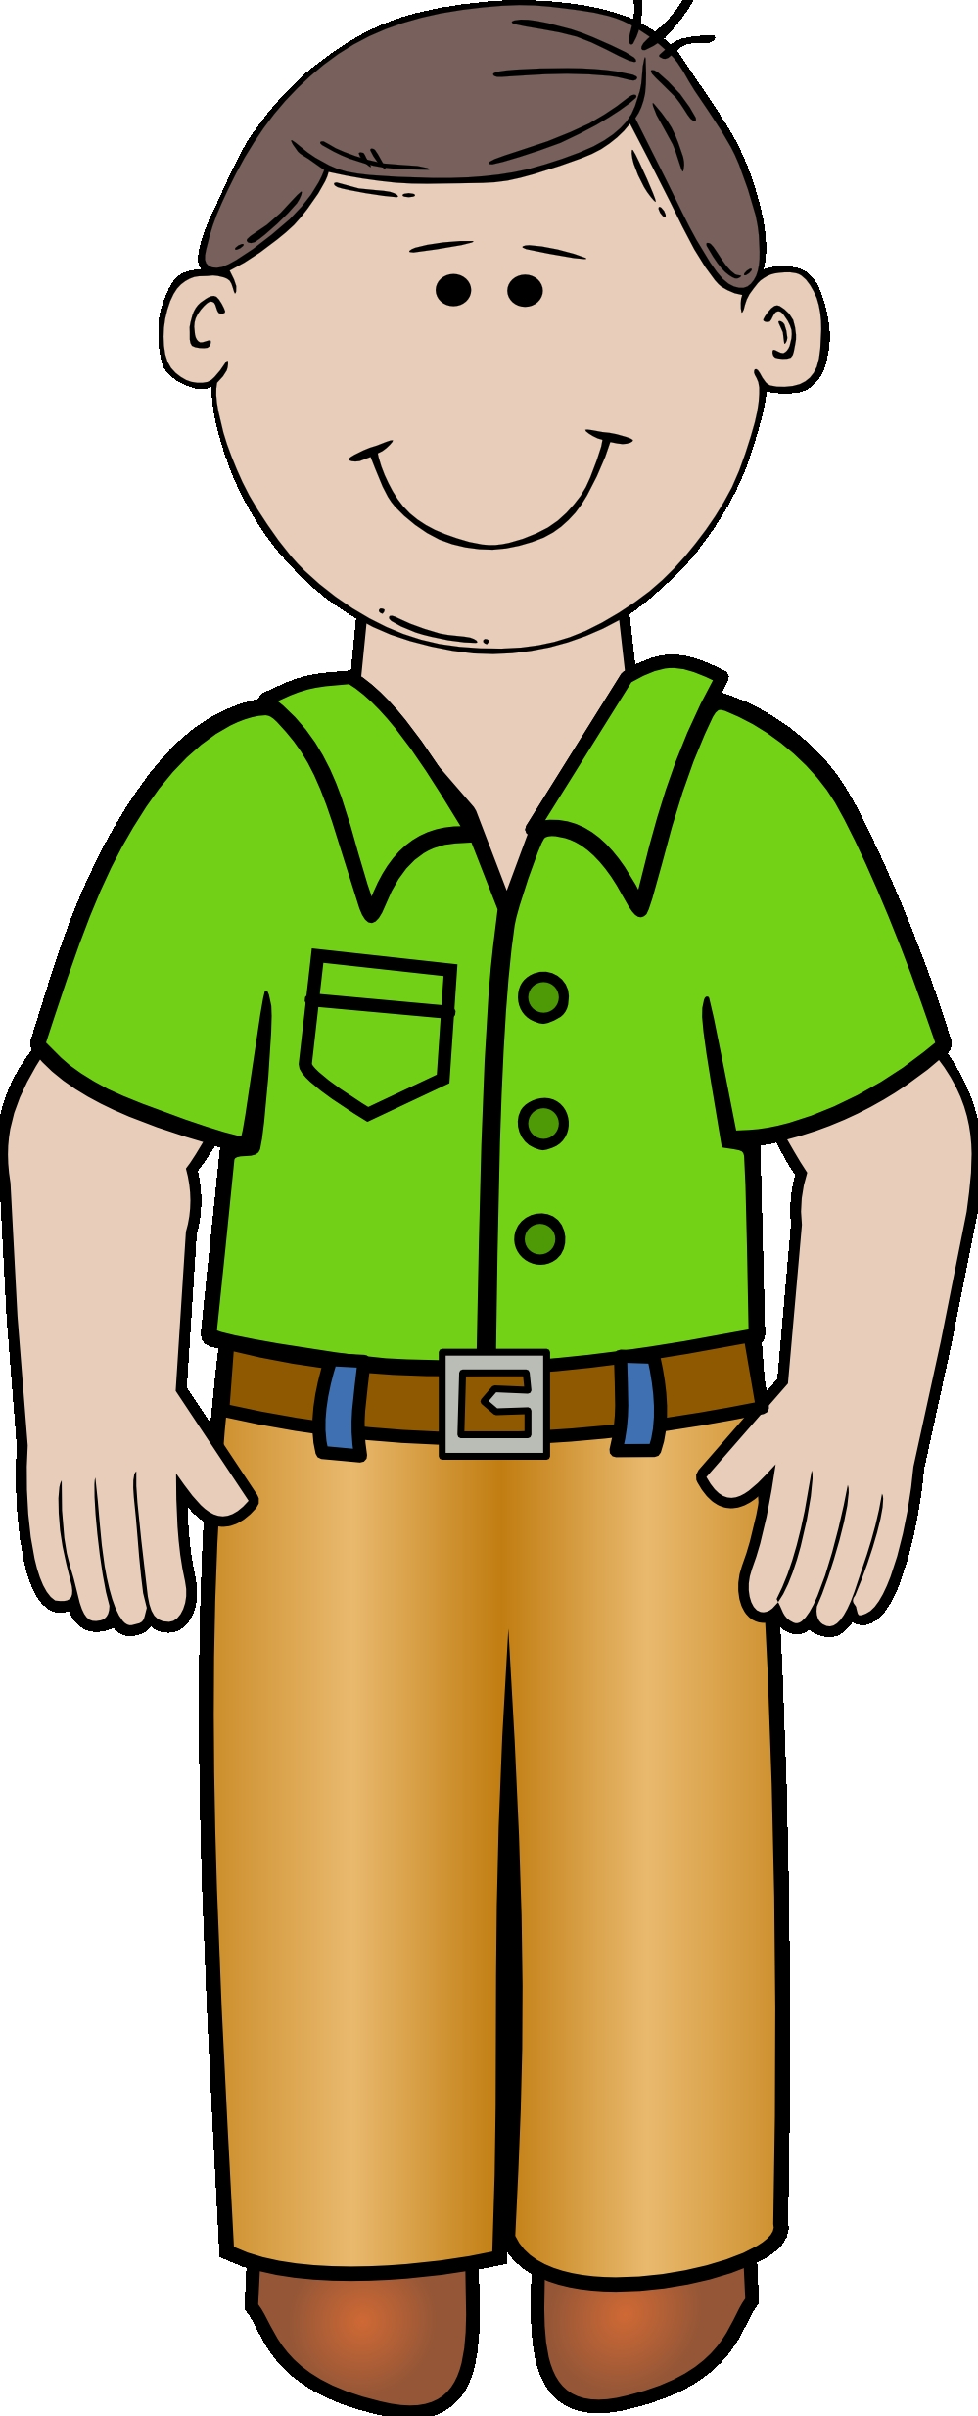
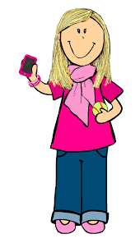
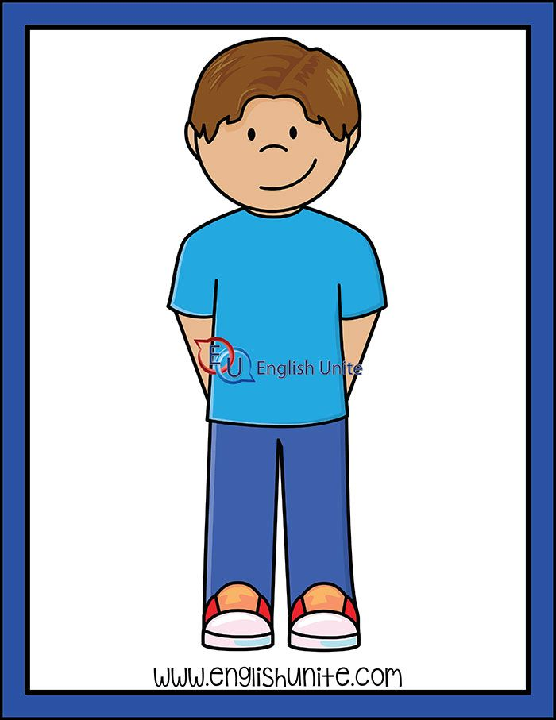
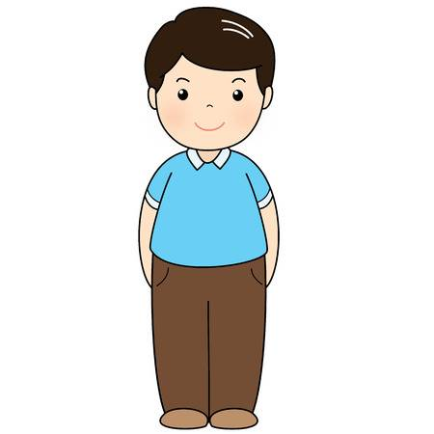
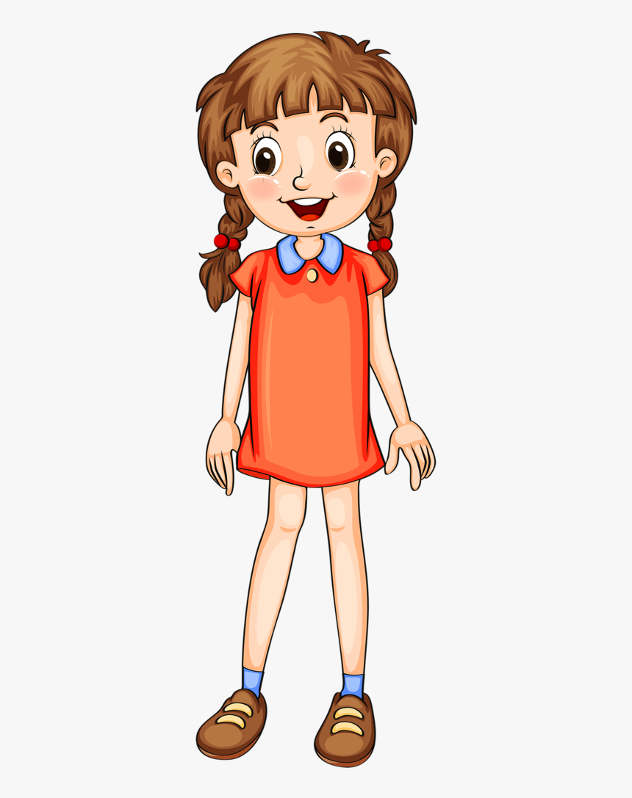
Drag the words in the right place.
grandad
brother
cousin
auntie
grandma
sister
mum
me
dad
uncle

Slide 2
Use his or her. Drag the right word.
her
her
This is Mary’s family. This is ____ dad. ____ name is Tom. This is ____ mum and _____ name is Kate. This is ____ brother. ____ name is Mike and ____ sister is Liza. ____ auntie is very nice. ____ name is Mina. _____ uncle is nice, too. _____ name is John.
her
her
her
her
her
her
his
his
his

