Slide 1

Colours

Slide 2

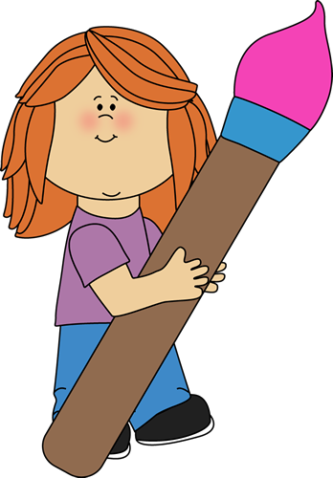
Let’s hear the “Rainbow song” to remember the colours!

Slide 3
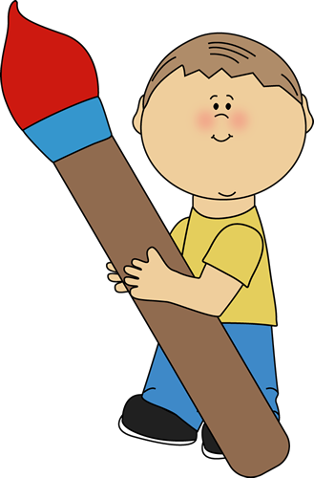

This video is a listening colours’ game! How fast can you say the colours?

Slide 4
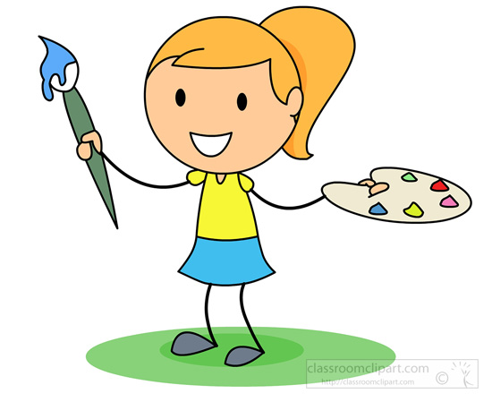
Do you remember our friend Gogo? Next, let’s see a video with Gogo’s adventures with colours!

Slide 5
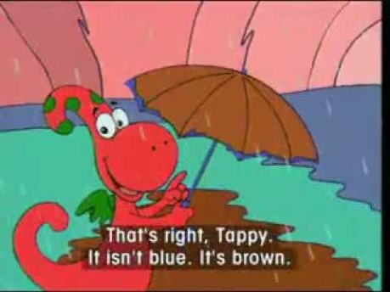

Slide 6
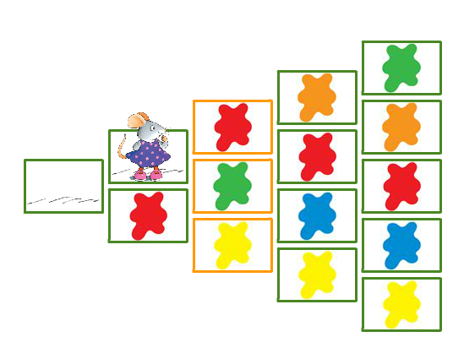

Listen to the colour and click on it to help the mouse find its way home! Click on the smiley to play!

Slide 7
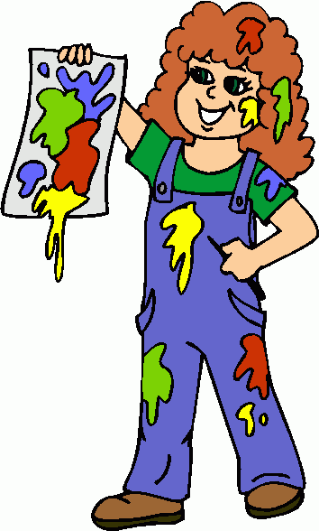
More games to practice listening to colours !
http://enjoyenglish.free.fr/english/primaire/colours/pageshtm/colour1.htm
https://agendaweb.org/exercises/vocabulary/audio/colours/colours-1
http://enjoyenglish.free.fr/english/primaire/colours/pageshtm/colour4.htm
http://eslgamesworld.com/members/games/vocabulary/memoryaudio/colours/index.html

Slide 8
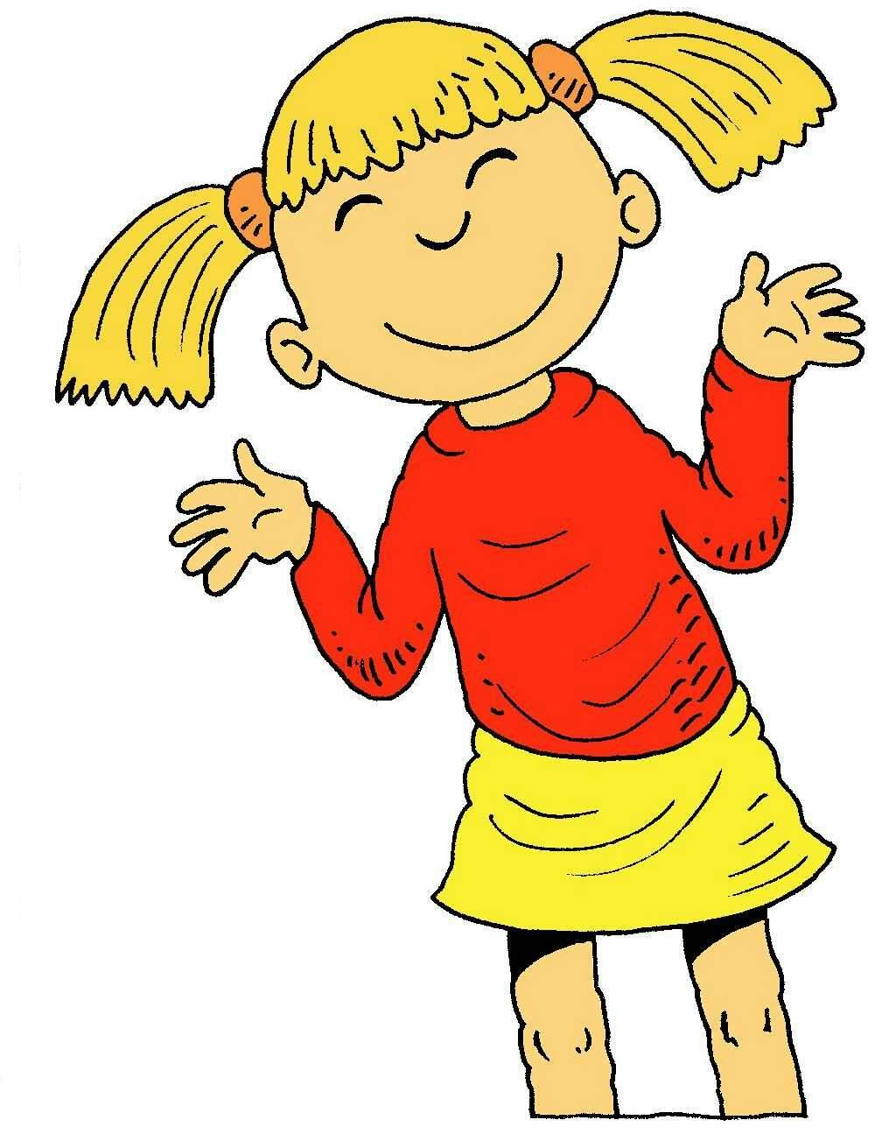
I ‘m sure you enjoy playing games! I love games too! Let’s play some more!

Slide 9
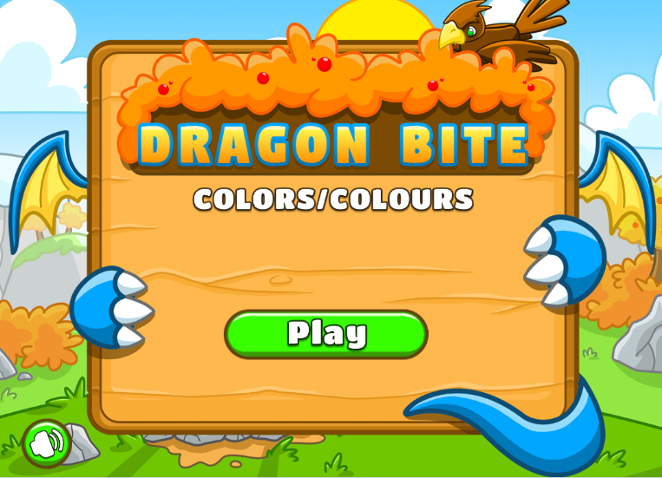
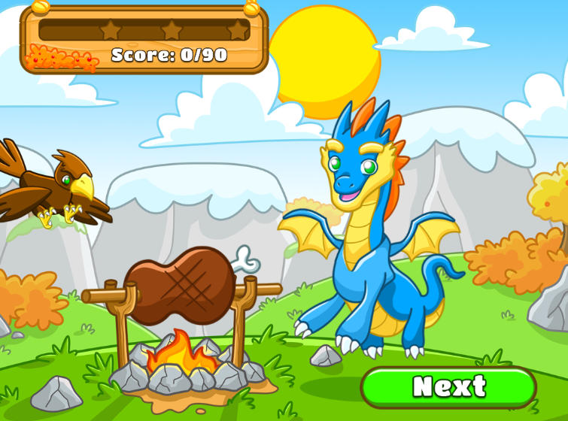
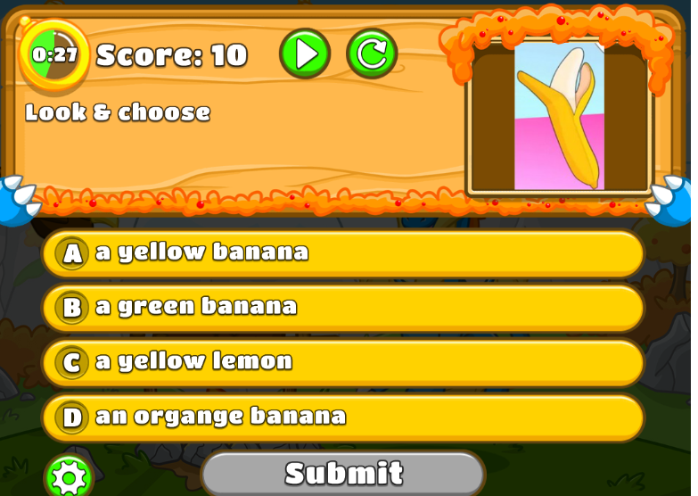
Click on the right answer to help the dragon protect its food!
https://www.eslgamesplus.com/colors-vocabulary-game-for-esl-learners-catapult-game/

Slide 10



Let’s play ‘’Simon says…’’
Simon says…

Slide 11
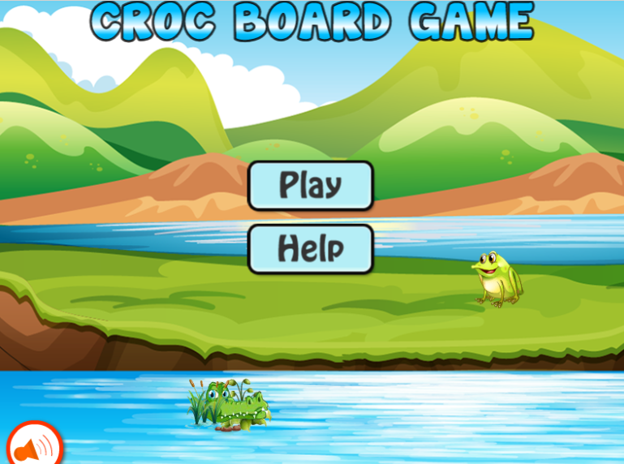
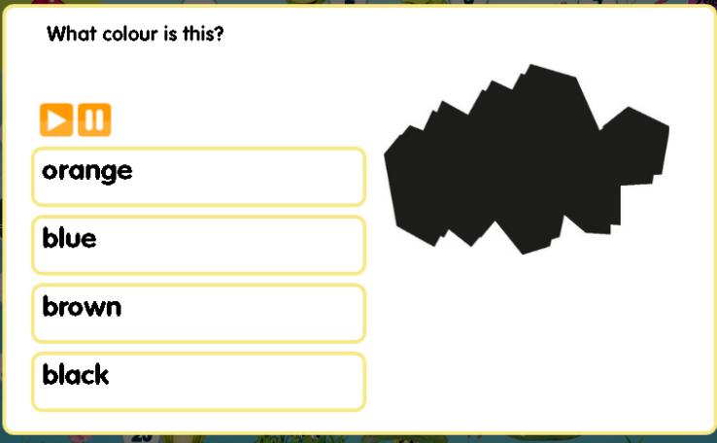
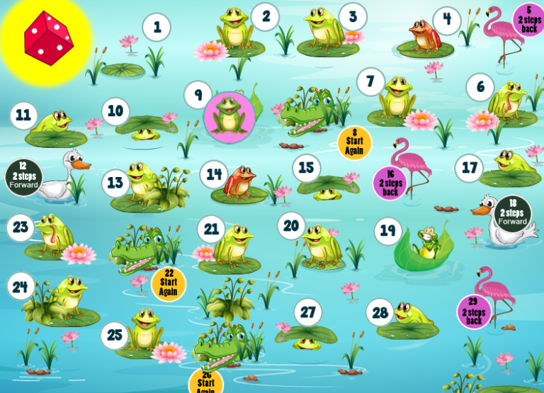

The crocodile board game!
Click on the link and then click on the dice to play!
https://www.eslgamesplus.com/colors-vocabulary-crocodile-board-game/

Slide 12


Yay!! Story time!! My favourite!

Slide 13

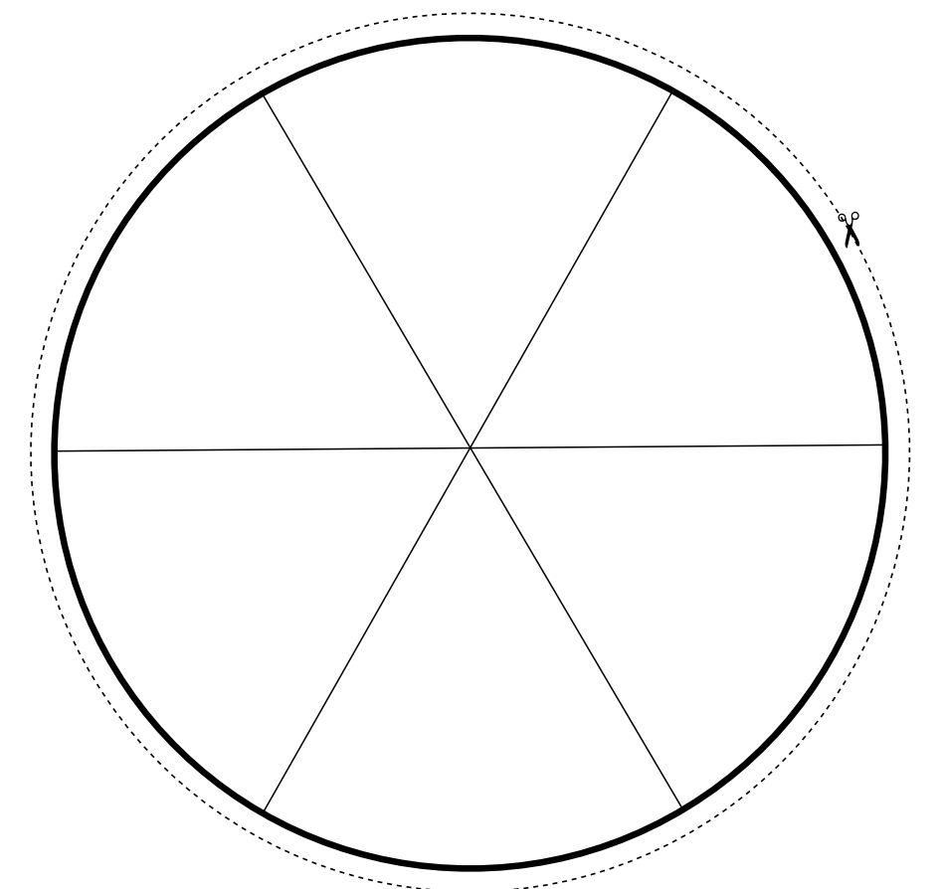

Do you want to learn more about mixing colours? Take a piece of paper, watch the video and let’s colour together!

Slide 14
The following games will help us read and write colours! Are you ready my friends?

Slide 15
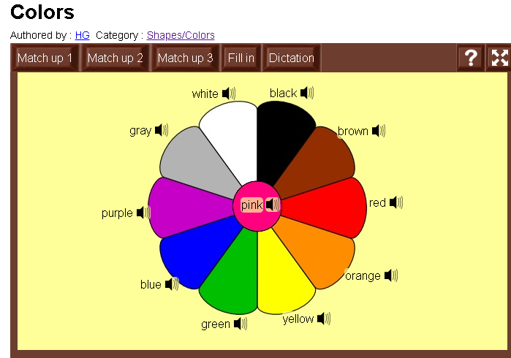
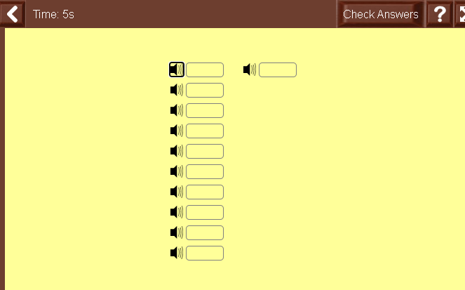
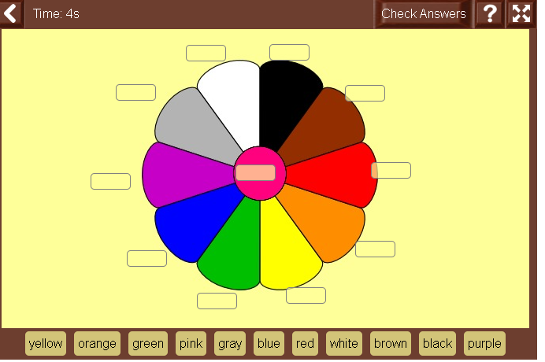
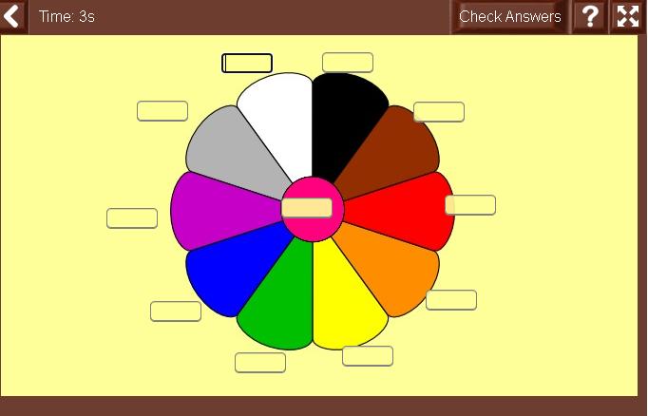
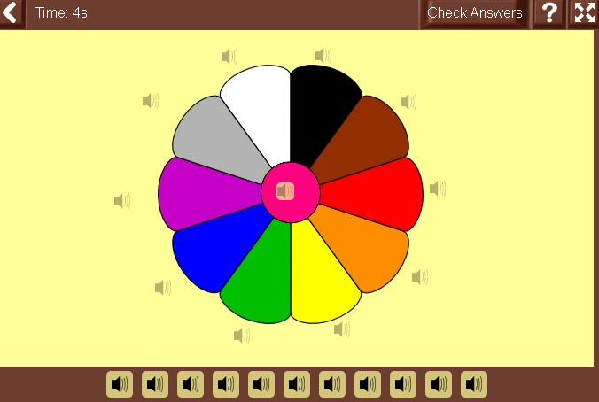
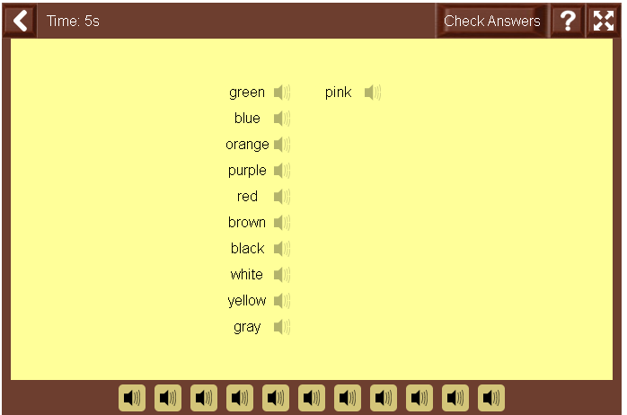
Click on the link and you will find six different activities!
https://www.learningchocolate.com/content/colors-0

Slide 16
More games to practice reading and writing colours !
https://agendaweb.org/exercises/vocabulary/colours-colors
https://www.myenglishpages.com/site_php_files/vocabulary-exercise-colors.php
https://agendaweb.org/exercises/vocabulary/colours/colours-match
http://www.adelescorner.org/vocab/colours/colours.html
https://literacycenter.net/play_learn/words_en/color_type_en.php

Slide 17
My friends let’s finish this colourful lesson with two fun songs!

Slide 18
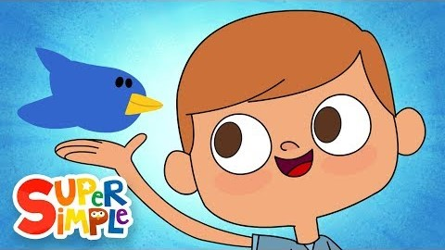
Listen to the song. They play a game!
If you like it then you can practice it at home!

Slide 19
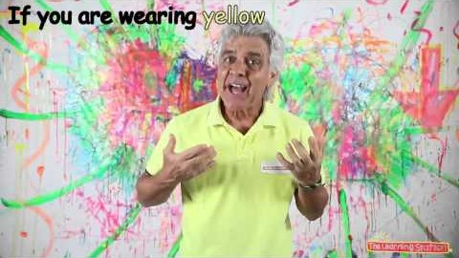
The best way to say goodbye! My favourite colour song! Can you do the moves with me?

Slide 20
Well done everybody!
See you next time!

Slide 21
Images courtesy of:
http://clipart-library.com

