Slide 1

Colours

Slide 2

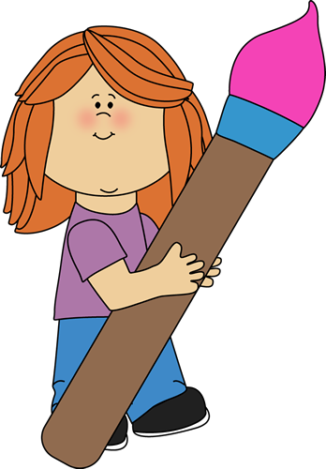


Let’s play ‘’Simon says…’’
Simon says…

Slide 3
Images courtesy of:
http://clipart-library.com

